Slide 1



Network Modeling with SIS
29-08-2025
Sineshaw Legese Bayu
Rahma Jumaa Sheshe
Frank Chacky
Charles Arnest Obat
Sahar Trabelsi

Slide 2
Scenario

Slide 3
Scenario
In this project, we modeled how malaria could spread within an international training program by representing ourselves as a social network. Each participant was treated as a node, and connections captured interactions, with Kenya serving as a central hub linking individuals from multiple countries. Using the Susceptible-Infected-Susceptible (SIS) model, we simulated how infection flows through the network under different conditions—such as varying transmission (β = 0.4) and recovery (γ = 0.1) rates. We then tested public health interventions, like introducing masks or targeting superspreaders, to observe how network structure and individual roles influence outbreak dynamics.

Slide 4
Network Modeling with SIS
Builds social networks from participants across countries (Kenya as hub)
Uses SIS model to simulate disease spread
Key parameters: β = 0.4 (transmission), γ = 0.1 (recovery)
Explores interventions: mask-wearing, superspreaders, mid-outbreak measures.

Slide 5
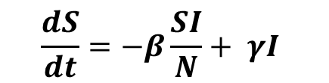


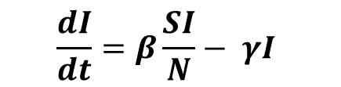
Flow Diagram & Differential Equation
transmission
susceptible humans
$$β=0.4$$
infectious
humans
$$γ=0.1$$
recovery
$$\frac{dS}{dt}=−β\frac{SI}{N}+ γI$$
SIS Model
$$\frac{dI}{dt}=β\frac{SI}{N}− γI$$
Notes:
S(t) = number of susceptible individuals at time t,
I(t) = number of infectious individuals at time t,
N is the total population N=S(t)+I(t)
β is the transmission rate,
γ is the recovery rate.

Slide 6
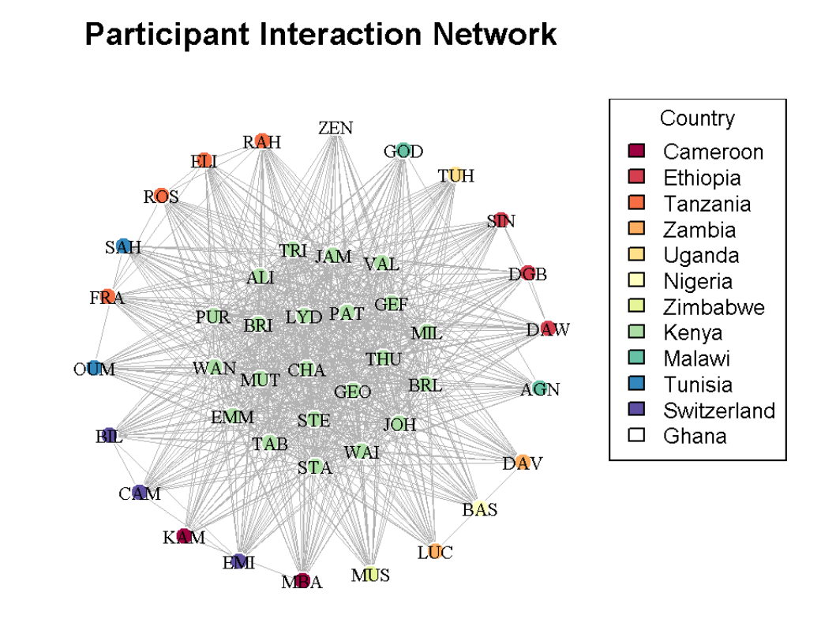
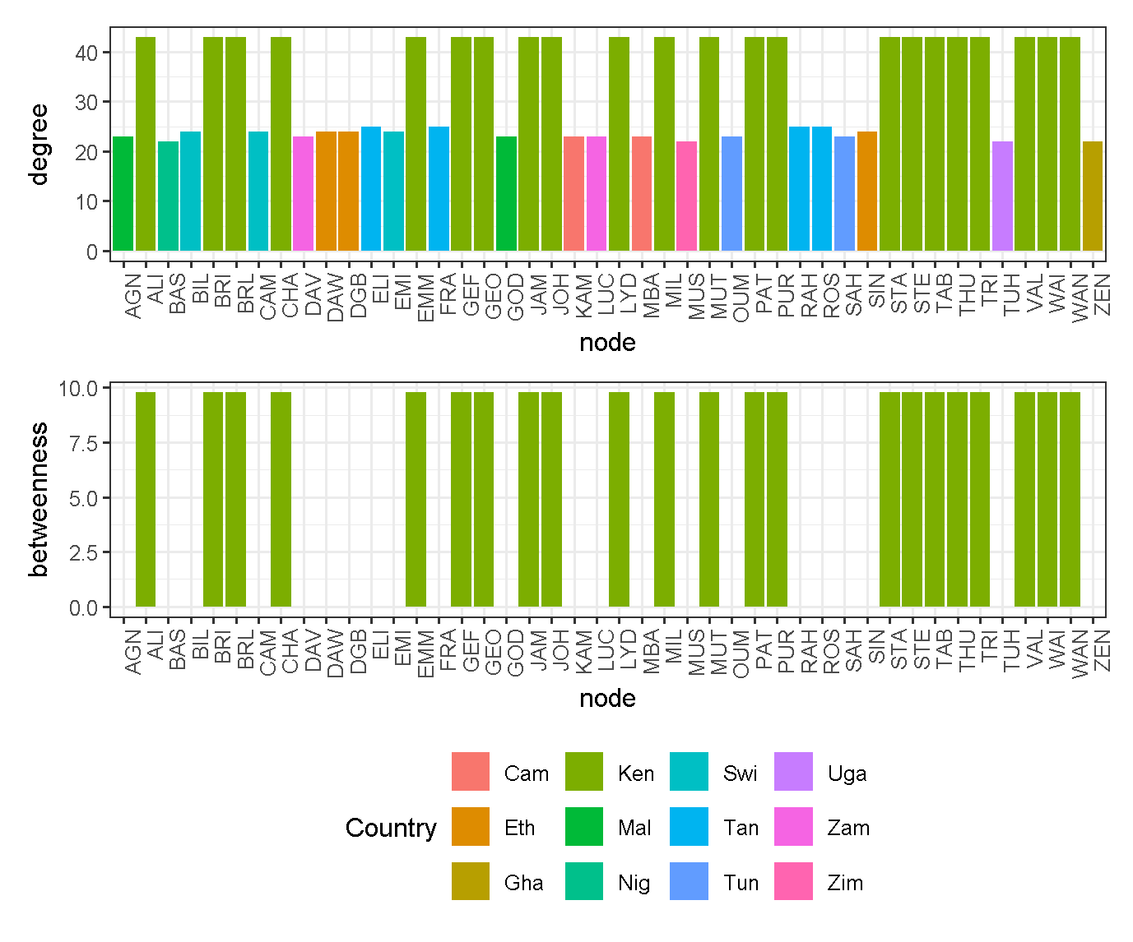
Network Description
Notes:
Number of participant = kenya =22, other 1-4
Total connection: 0.773
Edge_density = 0.77
max_degree = 43
Min_degree = 23
Max_betweenness = 9.77
Min_betweenness=0

Slide 7
Exercises
What is betweenness centrality. Redraw the network with node sizes proportional to the node betweenness. How does this differ from degree centrality?
Betweenness centrality measures how often that node lies on the shortest paths between other pairs of nodes in the network.
Example: Connection of
ZN --- BA --- MY --- LY where BA= Highest , MY= second highest
| betweenness = 4 betweenness = 2
SH

Slide 8
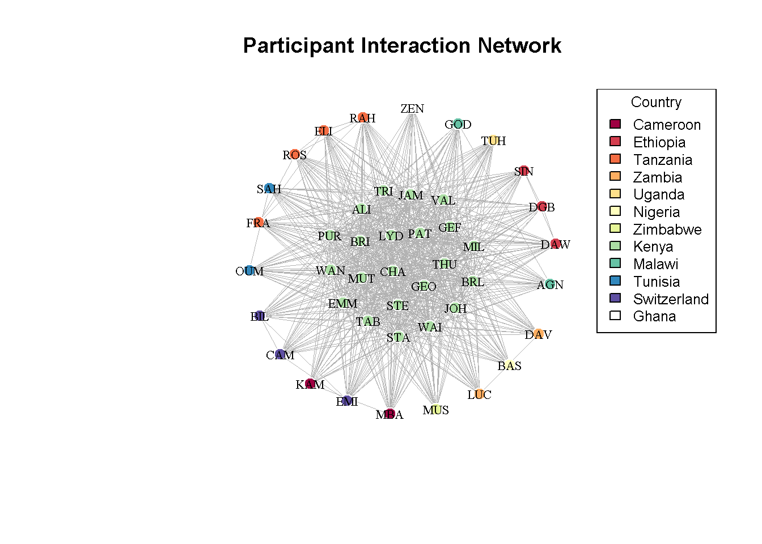
PART 1: NETWORK CONSTRUCION
Model Interpretation
Nodes = participants (colored by country).
Edges = interactions between participants.
Kenya (green nodes) is centrally located, acting as a hub linking participants from multiple nations.
Network density shows frequent cross-country connections.
Highly connected nodes (super-spreaders) are key drivers of potential disease spread

Slide 9
Part 4. ANALYSIS AND RESULTS
Network Metrics:
Network density: 0.773
Super-spreader analysis
Without super-spreaders: 41 infected
With super-spreaders: 41 infected
Additional infections from super-spreaders: 0
Effect of changing interaction rates
Beta Final_Infected 1 0.01 5 2 0.02 6 3 0.03 17 4 0.04 20 5 0.05 35
Number of infected individuals:
Day 2: 42 people
Day 4: 42 people
Day 8: 39 people
Incidence on Day 8: 7 new infections
With masks from Day 5
Infections on Day 5 with masks: 42
Infections averted: 0

Slide 10
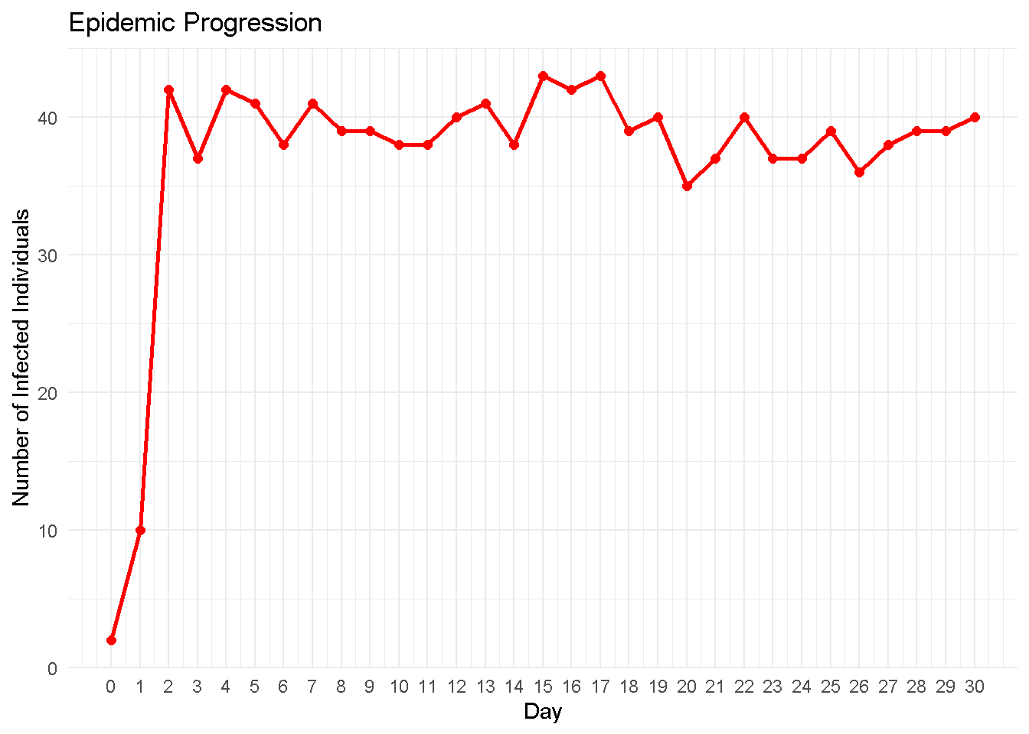
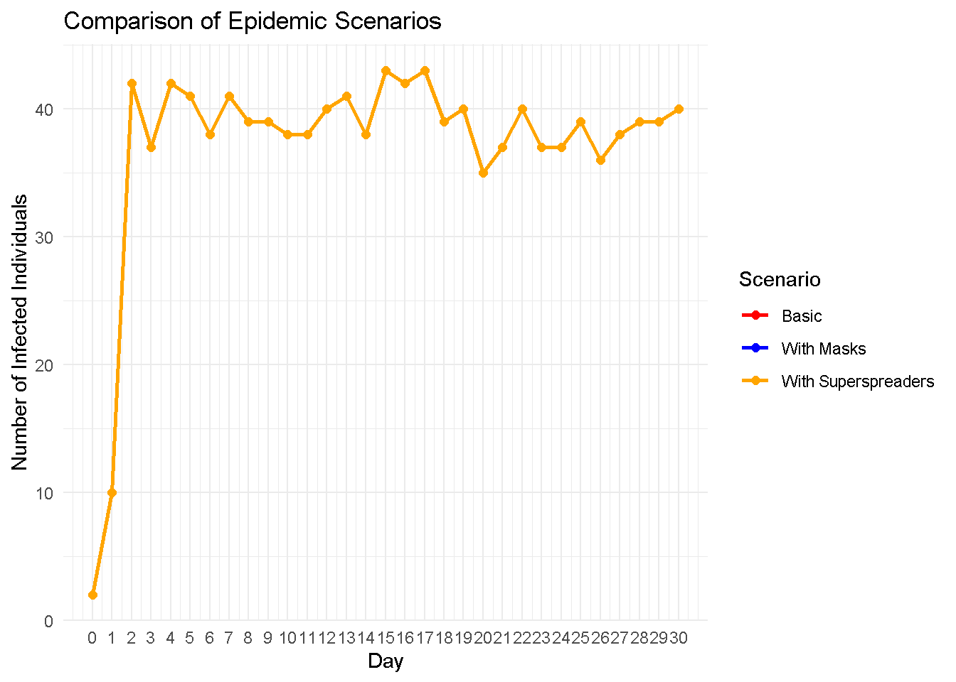
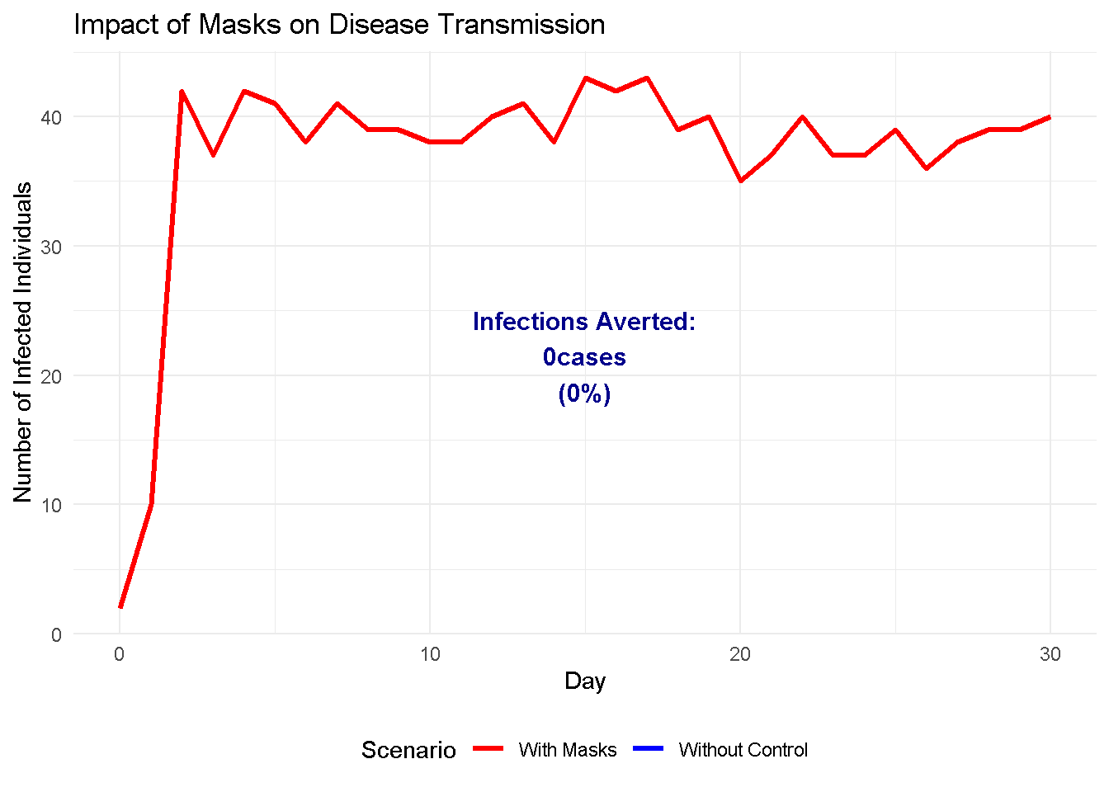
VISUALIZATION OF EPIDEMIC PROGRESSION
Network has 44 participants and 731 connections
Density: 0.773 - indicates a highly connected network

Slide 11
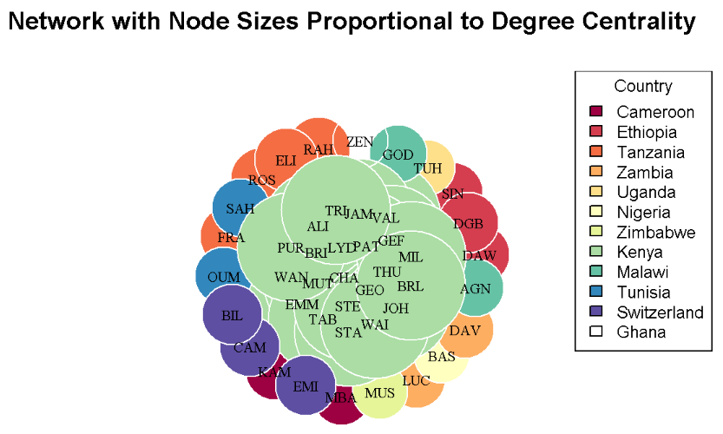
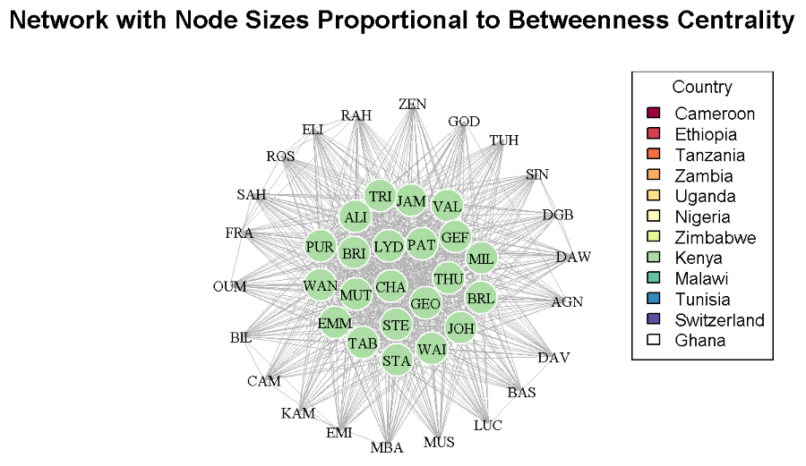
Exercise 1: Network with Node sizes proportional: Degree and betweenness centrality
Degree Centrality Comparison:
Kenya participants - Mean degree: 43
Other countries - Mean degree: 23.45
Kenya participants are 1.8 times more connected

Slide 12
Exercise 1.2: Calculate and compare betweenness centrality for Kenya vs other countries
Calculate and compare betweenness centrality for Kenya vs other countries
Identify least 3 connected individuals
Betweenness Centrality Comparison:
Kenya participants - Mean degree: 9.77
Other countries - Mean degree: 0
Kenya participants are Inf times more connected
THU (Uganda) = 22 connections
BAS (Nigeria) = 22 connections
MUS (Zimbabwe) = 22 connections

Slide 13
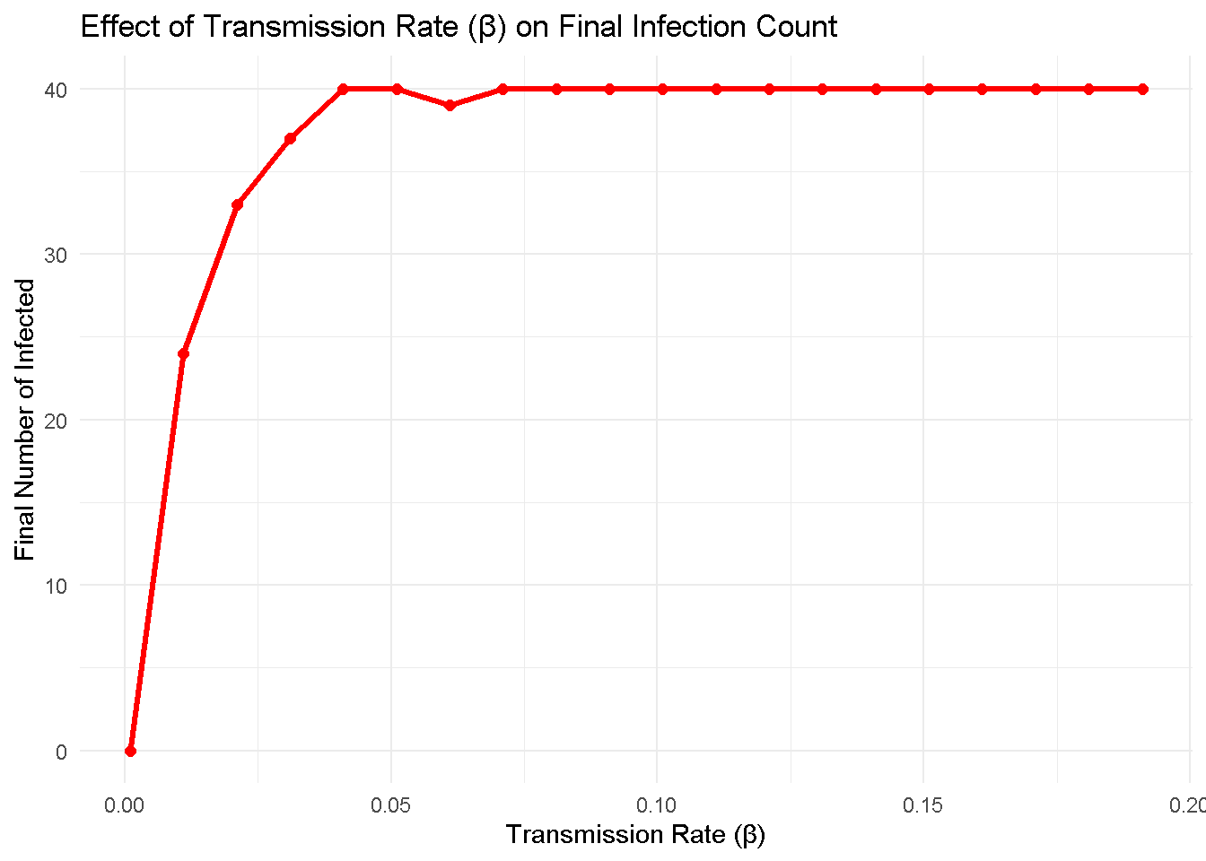
Exercise 2: Parameter Sensitivity Analysis
Run SIS model with different β values and plot
The infection plateaus because the epidemic reaches an equilibrium (Beta=0.071, I=40)
  Where no more people can be infected.
Once the susceptible pool is exhausted:
  The outbreak stops, regardless of how high the transmission rate (β) is.
  The plateau simply reflects the population limit, not the strength of transmission

Slide 14
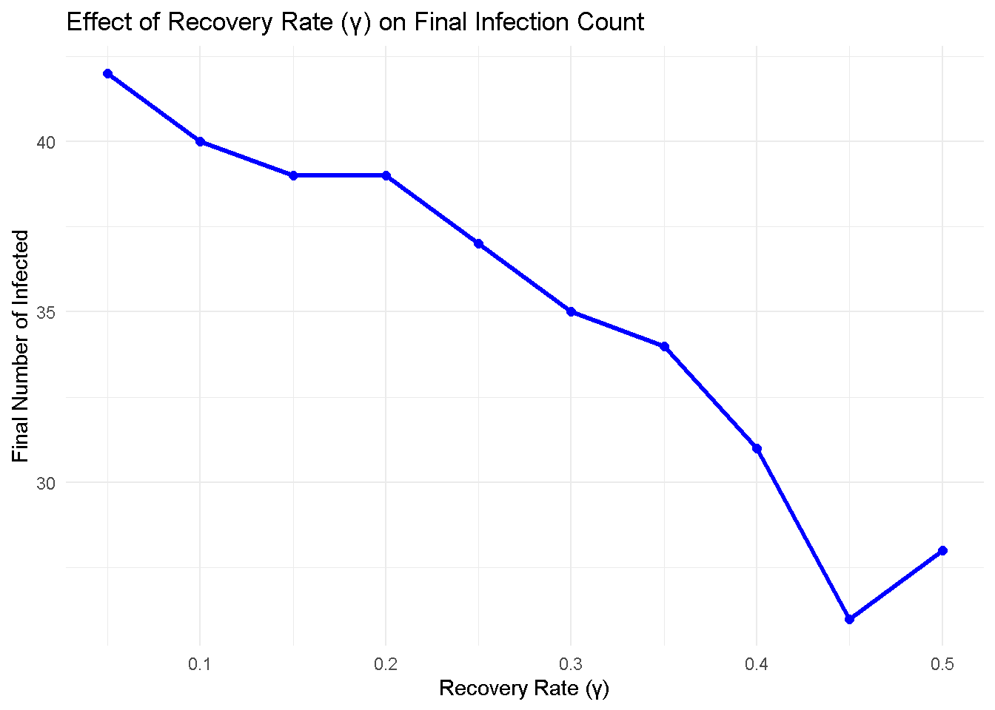
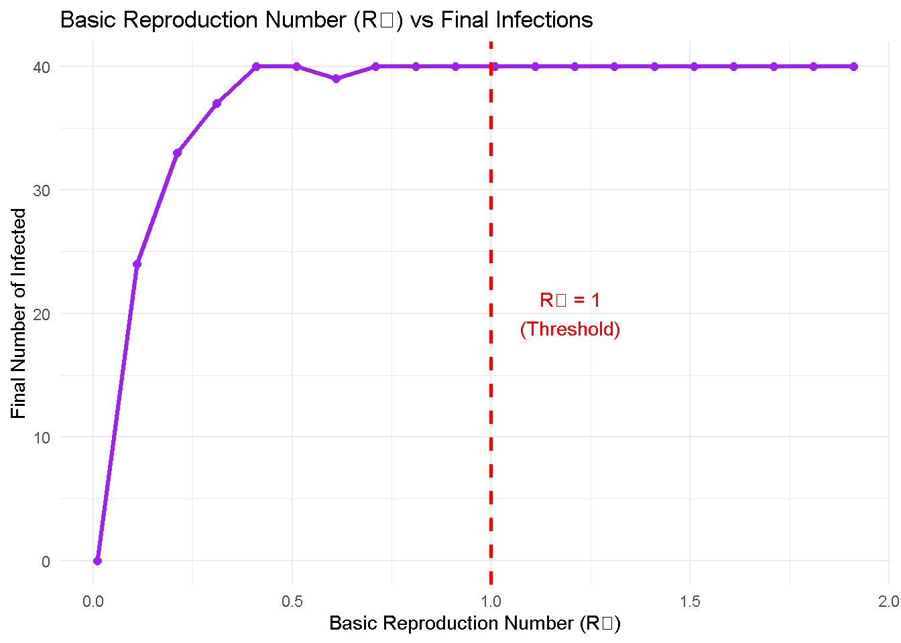
Notes:
R₀ Analysis: Epidemic threshold occurs at R₀ = 1
When R₀ < 1: Disease dies out
When R₀ > 1: Disease persists and spreads

Slide 15
Exercise 2.2: What is R₀? How would you use the knowledge of R₀ for disease control? What’s another way to calculate R₀ as Billy showed in class?
Basic reproductive number(R₀) is the average number of secondary cases caused by infected person in a completely susceptible population.
Analysis:
When R₀ = 1: The disease neither grows nor dies quickly
When R₀ < 1: Disease dies out
When R₀ > 1: Disease persists and spreads
Another ways to define R₀:
R₀= β/ (ϒ + τ) where τ is the treatment rate

Slide 16
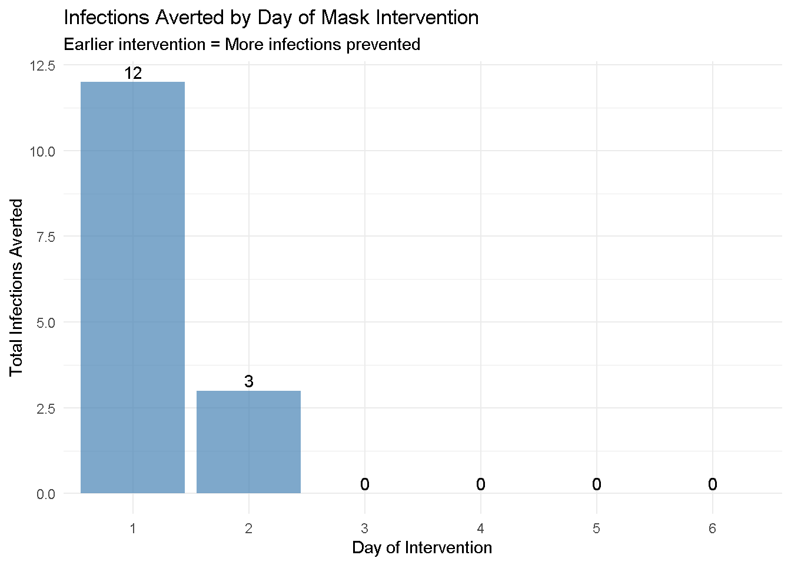
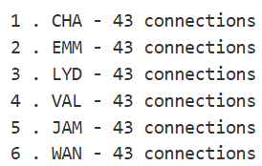
Exercise 3: Intervention Timing Analysis
Intervention Timing Results
Day 1 intervention: 12 infections averted
Day 2 intervention: 3 infections averted
Day 3 intervention: 0 infections averted
Day 4 intervention: 0 infections averted
Day 5 intervention: 0 infections averted
Day 6 intervention: 0 infections averted
Top 6 most connected individuals:
Notes:
Smaller infected population to control
Prevents exponential growth phase
Delays can lead to overwhelming healthcare systems

Slide 17
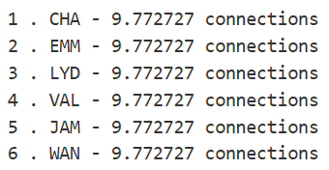
Exercise 3.1: Who are the top 6 most connected individuals abased on betweenness? Do they differ from those based on degree centrality? Comment on whether they are different or the same - why?
Top 6 most connected individuals
Superspreader Effect Analysis
Baseline (no superspreaders): 1150 total infections
Most connected as superspreaders: 1151 total infections ( 0.1 % increase)
Random people as superspreaders: 1150 total infections ( 0 % increase)

Slide 18
Exercise 3.2: Calculate the superspreader
Degree Centrality
Betweenness Centrality
Baseline (no superspreaders): 1109 total infections
Most connected as superspreaders: 1126 total infections ( 1.5 % increase)
Random people as superspreaders: 1117 total infections ( 0.7 % increase)
Baseline (no superspreaders): 1109 total infections
Most connected as superspreaders: 1126 total infections ( 1.5 % increase)
Random people as superspreaders: 1117 total infections ( 0.7 % increase)
THEY DON’T DIFFER
In the network, the individuals with the most connections (high degree) also happen to be the ones having high bridging (high betweenness)

Slide 19

How many infections are prevented if we consider betweenness centrality isolation?
Top 3 most connected individuals based on betweenness
Targeted Intervention (Isolate top 3 connected) based on betweenness
With targeted intervention: 1077 total infections
Infections prevented: 73
Effectiveness: 6.3 % reduction

Slide 20
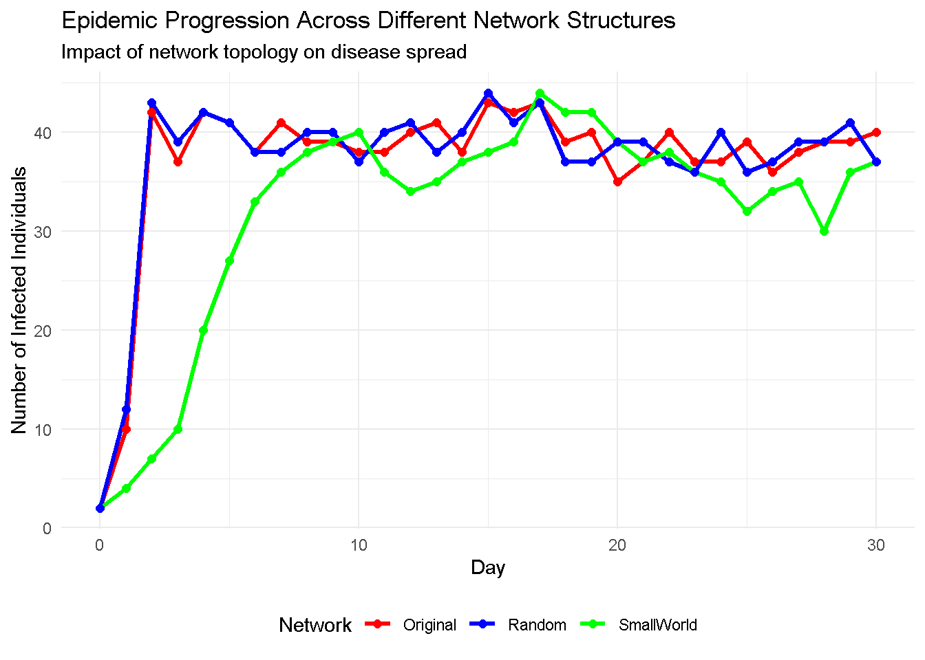
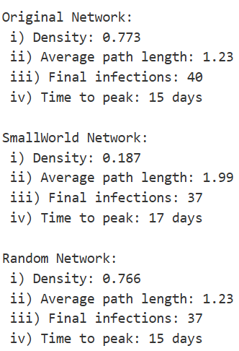
Network Structure Modification**
Network Structure Comparison

Slide 21
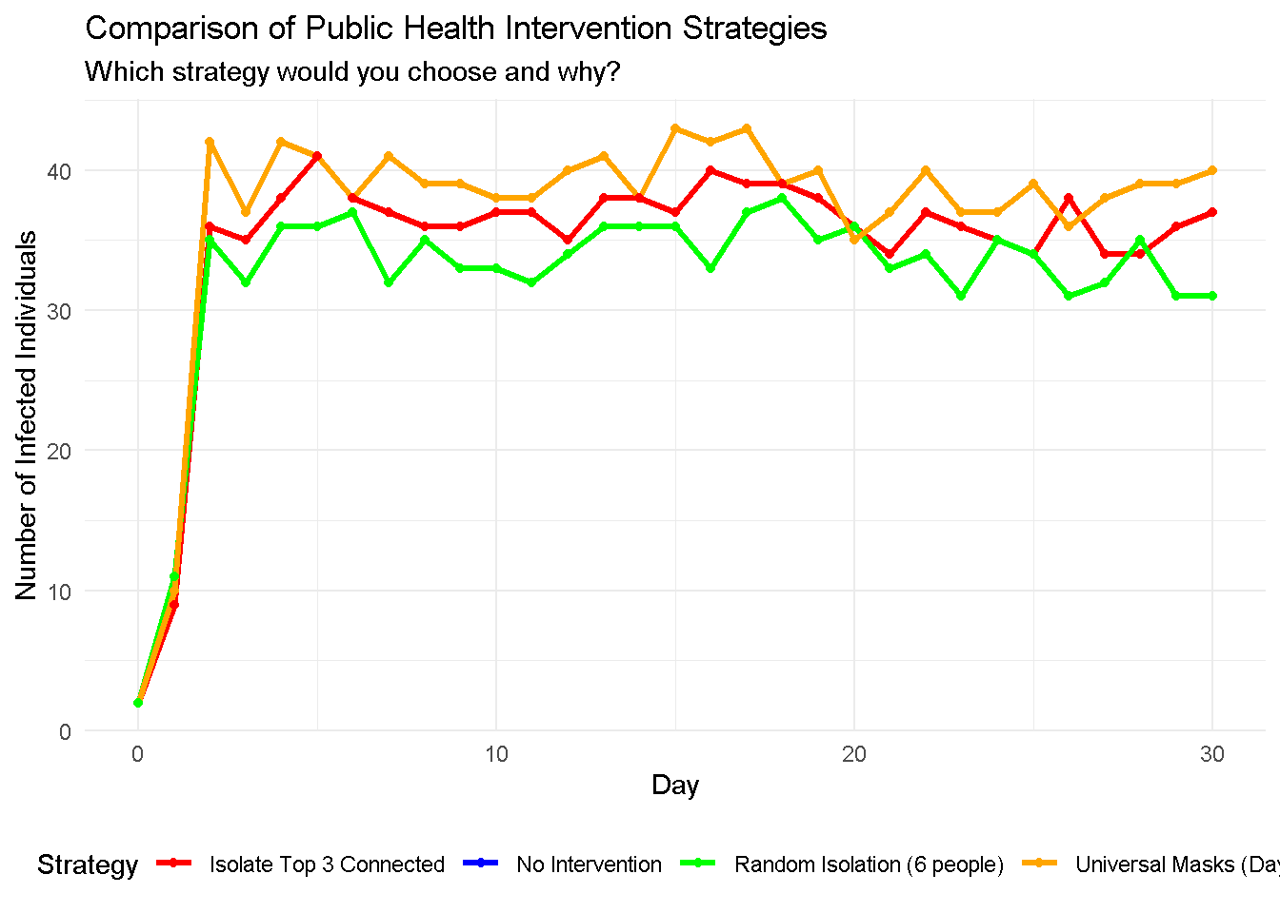
Exercise 4: General Epidemiological Modelling Questions
Public health official planning intervention strategies
Baseline (no intervention): 1150 total infections
Strategy A (Universal masks Day 3): 1150 total infections - 0 % reduction
Strategy B (Isolate top 3 connected): 1077 total infections - 6.3 % reduction
Strategy C (Random isolation of 6): 1002 total infections - 12.9 % reduction

Slide 22
BONUS ANALYSIS: Cost-Effectiveness
Assumed costs: Universal masking = $1000, Isolation = $500/person
Cost per infection prevented:
Strategy A: $ Inf per infection prevented
Strategy B: $ 21 per infection prevented
Strategy C: $ 20 per infection prevented

Slide 23
Conclusion
Network structure critically influences disease transmission
Early intervention is more effective than delayed action
Targeted interventions can be more efficient than broad measures
Public health decisions require balancing effectiveness, cost, and feasibility
Mathematical modelling helps evaluate intervention strategies before implementation

Slide 24

Acknowledgements
Christian Selinger
Emilie Pothin
Cameline Orlendo
Zenabu Suboi
Geoffrey Githinji
billy.bauzile@swisstph.ch

